Slide 1
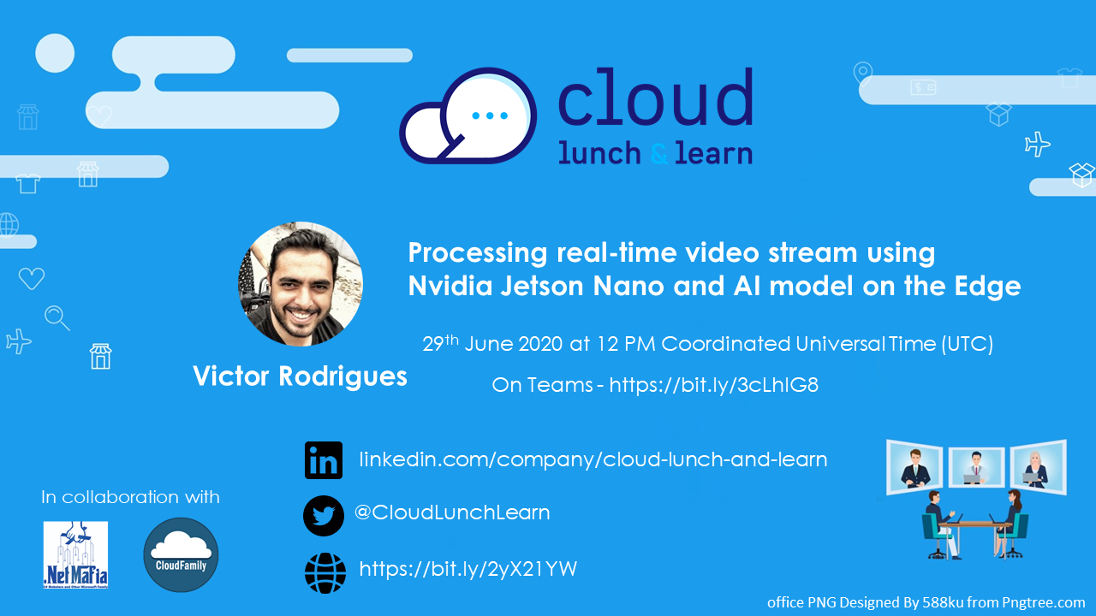

Slide 2


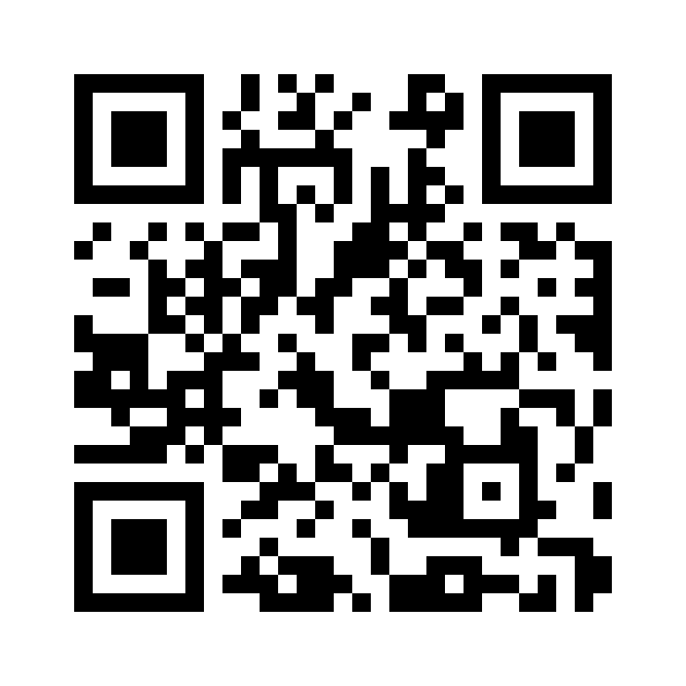


Azure IoT, Jetson Nano and AI
Scan this QR-code to access free resources, step-by-step learning guides as well as get practical experience in Azure IoT!
https://aka.ms/AA8r0h4
Don’t forget to add Microsoft Azure as a skill to your LinkedIn account to stay connected with a developer community!
+ Microsoft Azure
We post the latest announcements about free events for developers in Ireland on our official Twitter account!
@MSDevIRL

Slide 3







Victor Rodrigues
Azure Cloud Specialist for Application Modernization, Data Modernization, IoT, Machine Learning and AI at
Storm Technology.
@vhyrodrigues
linkedin.com/in/vrodrigues

Slide 4
Agenda
Introduction to Azure IoT Edge
Introduction to NVIDIA Jetson Nano Developer Kit
Introduction to NVIDIA DeepStream SDK
Deploy a Custom Vision Model to Azure IoT Edge with Azure IoT Hub

Slide 5
Azure IoT Edge
Built on container technology as ‘modules’
Modules support Python, NodeJS, .Net Core, Java, and C
Low-latency AMQP / MQTT data transport
Operate in offline / intermittent network conditions
Supports Linux X64 | ARM32/64, Windows X64

Slide 6
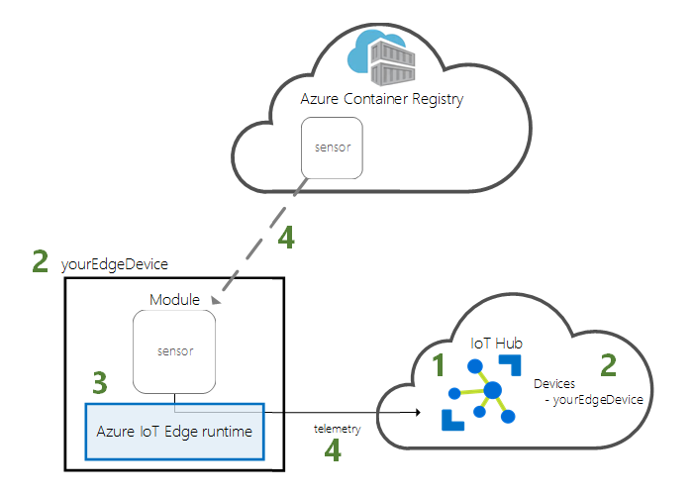
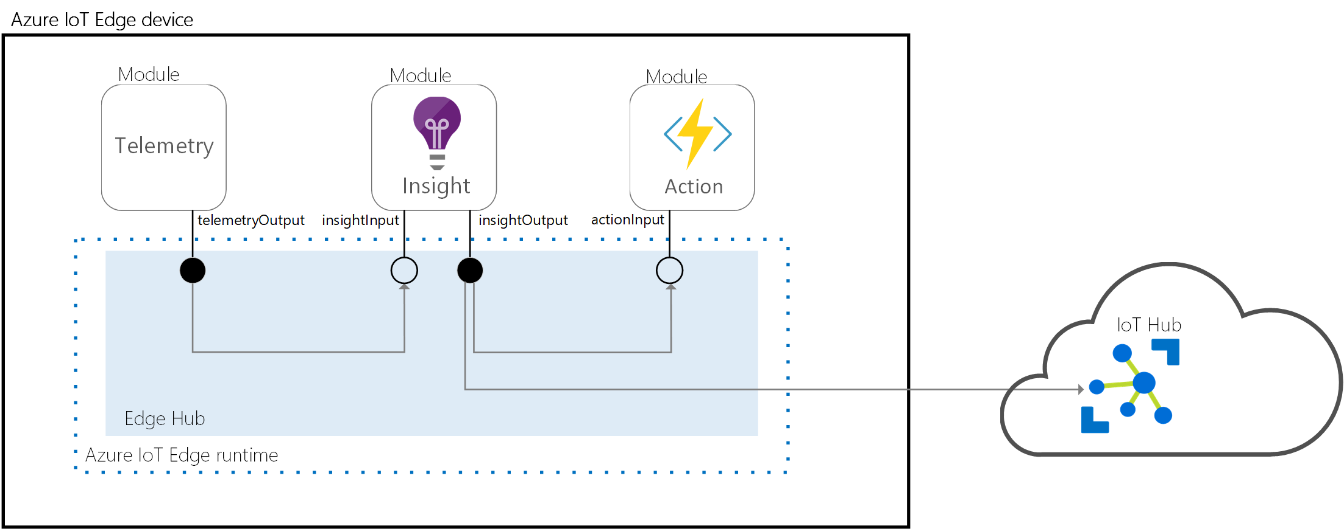
System Modules
EDGE-HUB
EDGE-AGENT

Slide 7
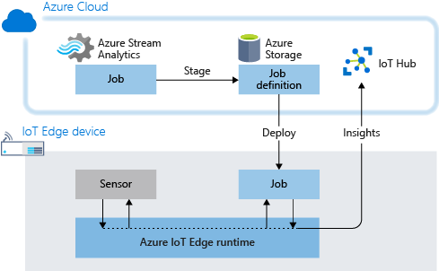
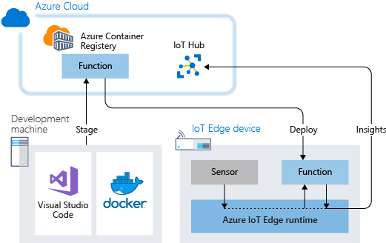
Azure Services as Edge Modules

Slide 8
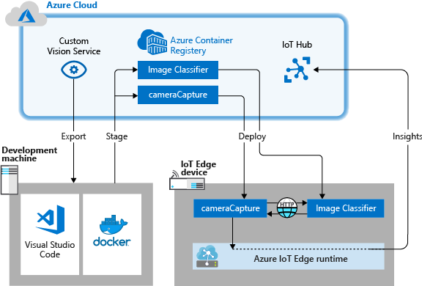
AI/ML Modules

Slide 9


Edge intelligence with Azure IoT Edge
IoT Devices
IoT Edge Devices
Azure Cloud
IoT Edge Runtime
Custom Vision
Module
on IoT Edge
Data
Data
Commands
Deployment
IoT Hub
Custom Vision

Slide 10
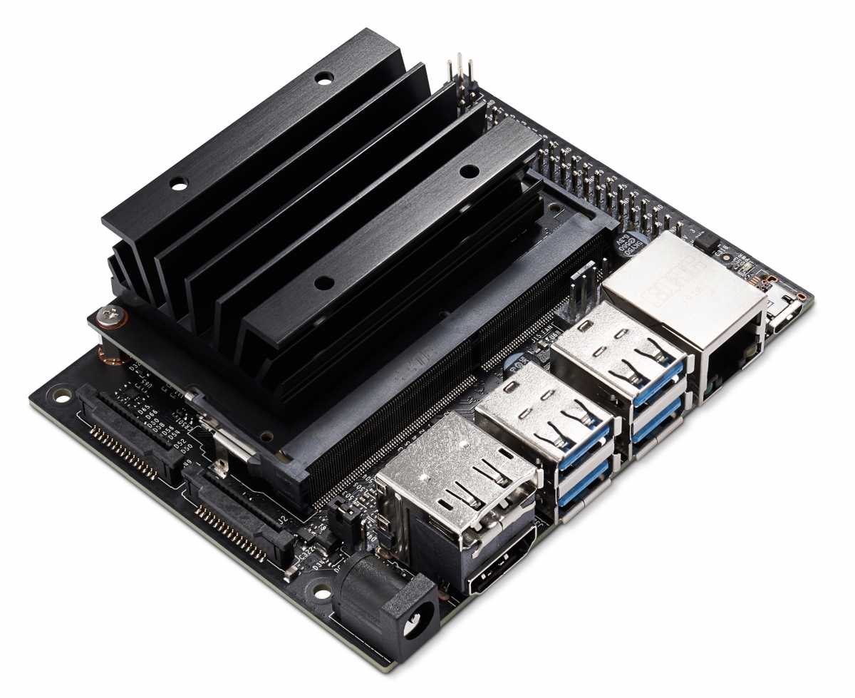
The hardware
Developer Kit Technical Specifications
GPU | 128-core Maxwell
CPU | Quad-core ARM A57 @ 1.43 GHz
Memory | 4 GB 64-bit LPDDR4 25.6 GB/s
Storage | microSD (not included)
Video Encoder | 4K @ 30 | 4x 1080p @ 30 | 9x 720p @ 30 (H.264/H.265)
Video Decoder | 4K @ 60 | 2x 4K @ 30 | 8x 1080p @ 30 | 18x 720p @ 30|
 | (H.264/H.265)
Others | GPIO, I2C, I2S, SPI, UART
Mechanical | 100 mm x 80 mm x 29 mm
Jetson Nano Developer Kit

Slide 11
The hardware
40-pin expansion header
microSD card slot
Micro-USB port for 5V power
input or for data
MIPI CSI camera connectors
Gigabit Ethernet port
DC Barrel jack for 5V power input
USB 3.0 ports (x4)
HDMI output port
DisplayPort connector
Jetson Nano Developer Kit

Slide 12
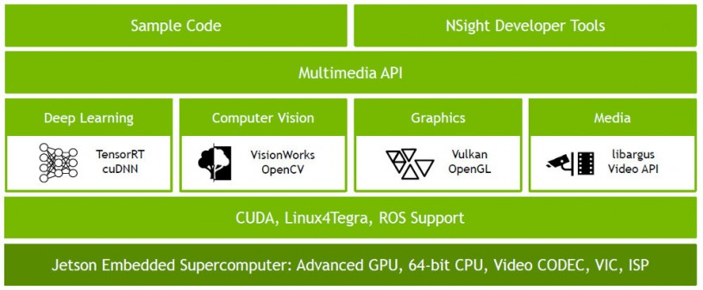
Nvidia TensorRT

Slide 13
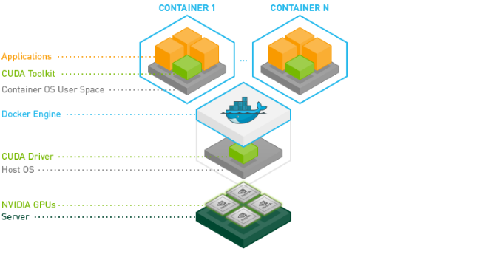
Nvidia Docker

Slide 14

The Solution
Azure IoT Hub
Custom Vision
Visual Studio Code
Azure IoT Edge
Simulated Cameras

Slide 15
Demo

Slide 16
Azure IoT, Jetson Nano and AI
Scan this QR-code to access free resources, step-by-step learning guides as well as get practical experience in Azure IoT!
https://aka.ms/AA8r0h4
Don’t forget to add Microsoft Azure as a skill to your LinkedIn account to stay connected with a developer community!
+ Microsoft Azure
We post the latest announcements about free events for developers in Ireland on our official Twitter account!
@MSDevIRL

Slide 17
Resources
Useful links
NVIDIA Jetson Nano Developer Kit (https://developer.nvidia.com/embedded/jetson-nano-developer-kit)
NVIDIA DeepStream SDK (https://developer.nvidia.com/Deepstream-sdk)
NVIDIA Developer Program (https://developer.nvidia.com/)
NVIDIA Deepstream + Azure IoT Edge on a NVIDIA Jetson Nano (https://github.com/Azure-Samples)
Getting started with Azure IoT Edge (https://azure.microsoft.com/en-us/services/iot-edge/)
Getting started with Azure IoT Hub (https://azure.microsoft.com/en-us/services/iot-hub/)

Slide 18
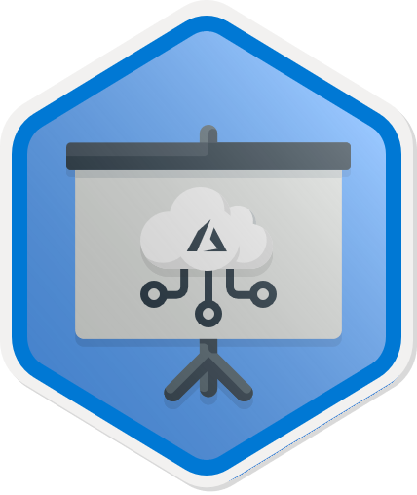

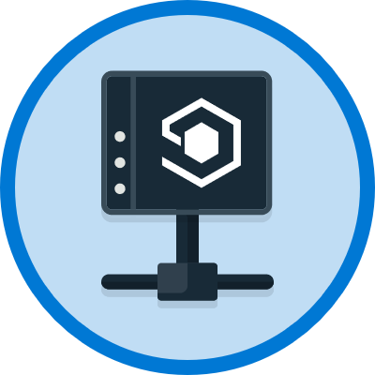
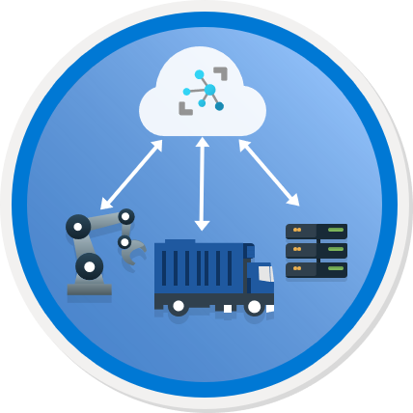

Cloud Lunch and Learn IoT Series
Overview of IoT Services
07/08
Creating you first
Azure IoT Central App
28/08
Connecting IoT device to Azure
14/08
Setting up IoT Edge device
21/08
12 PM Coordinate Universal Time (UTC)

Slide 19
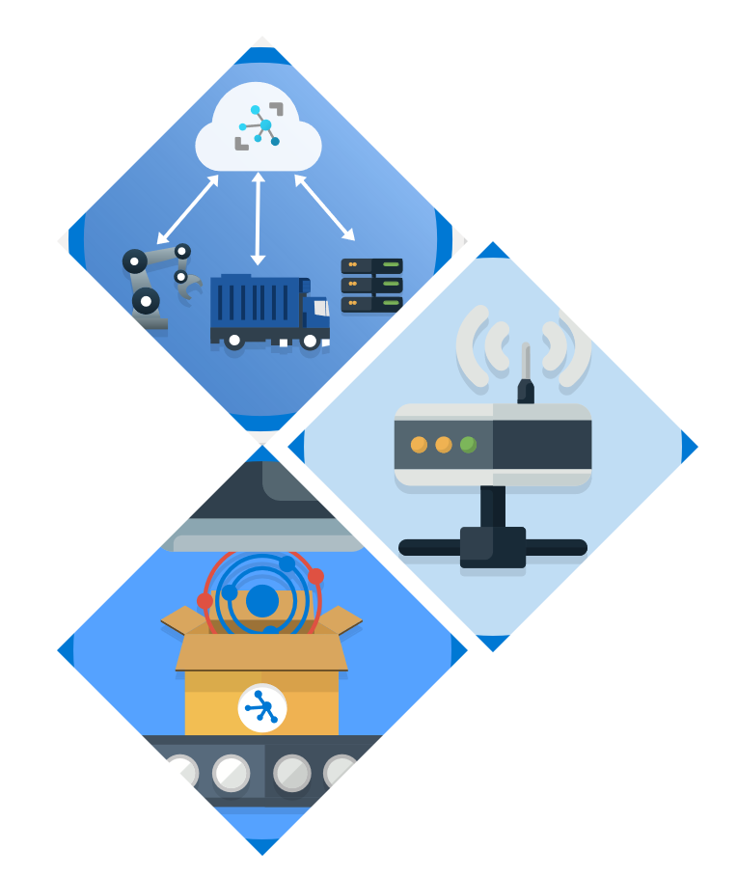
Thank you!!!
Victor Rodrigues
@vhyrodrigues
linkedin.com/in/vrodrigues

